Slide 1

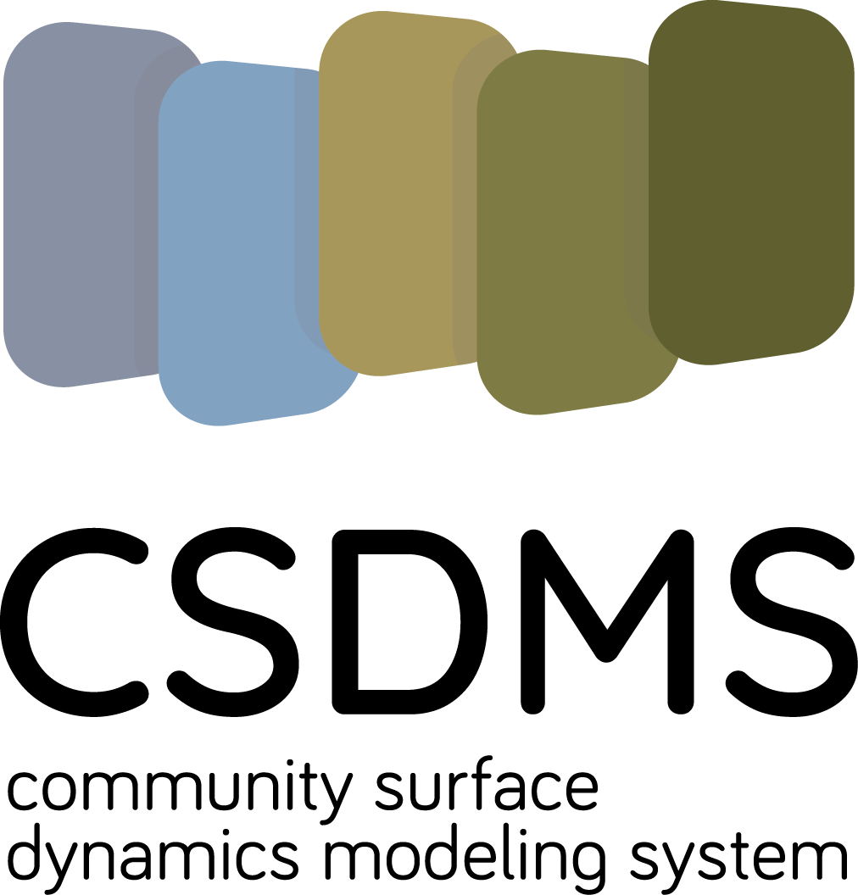
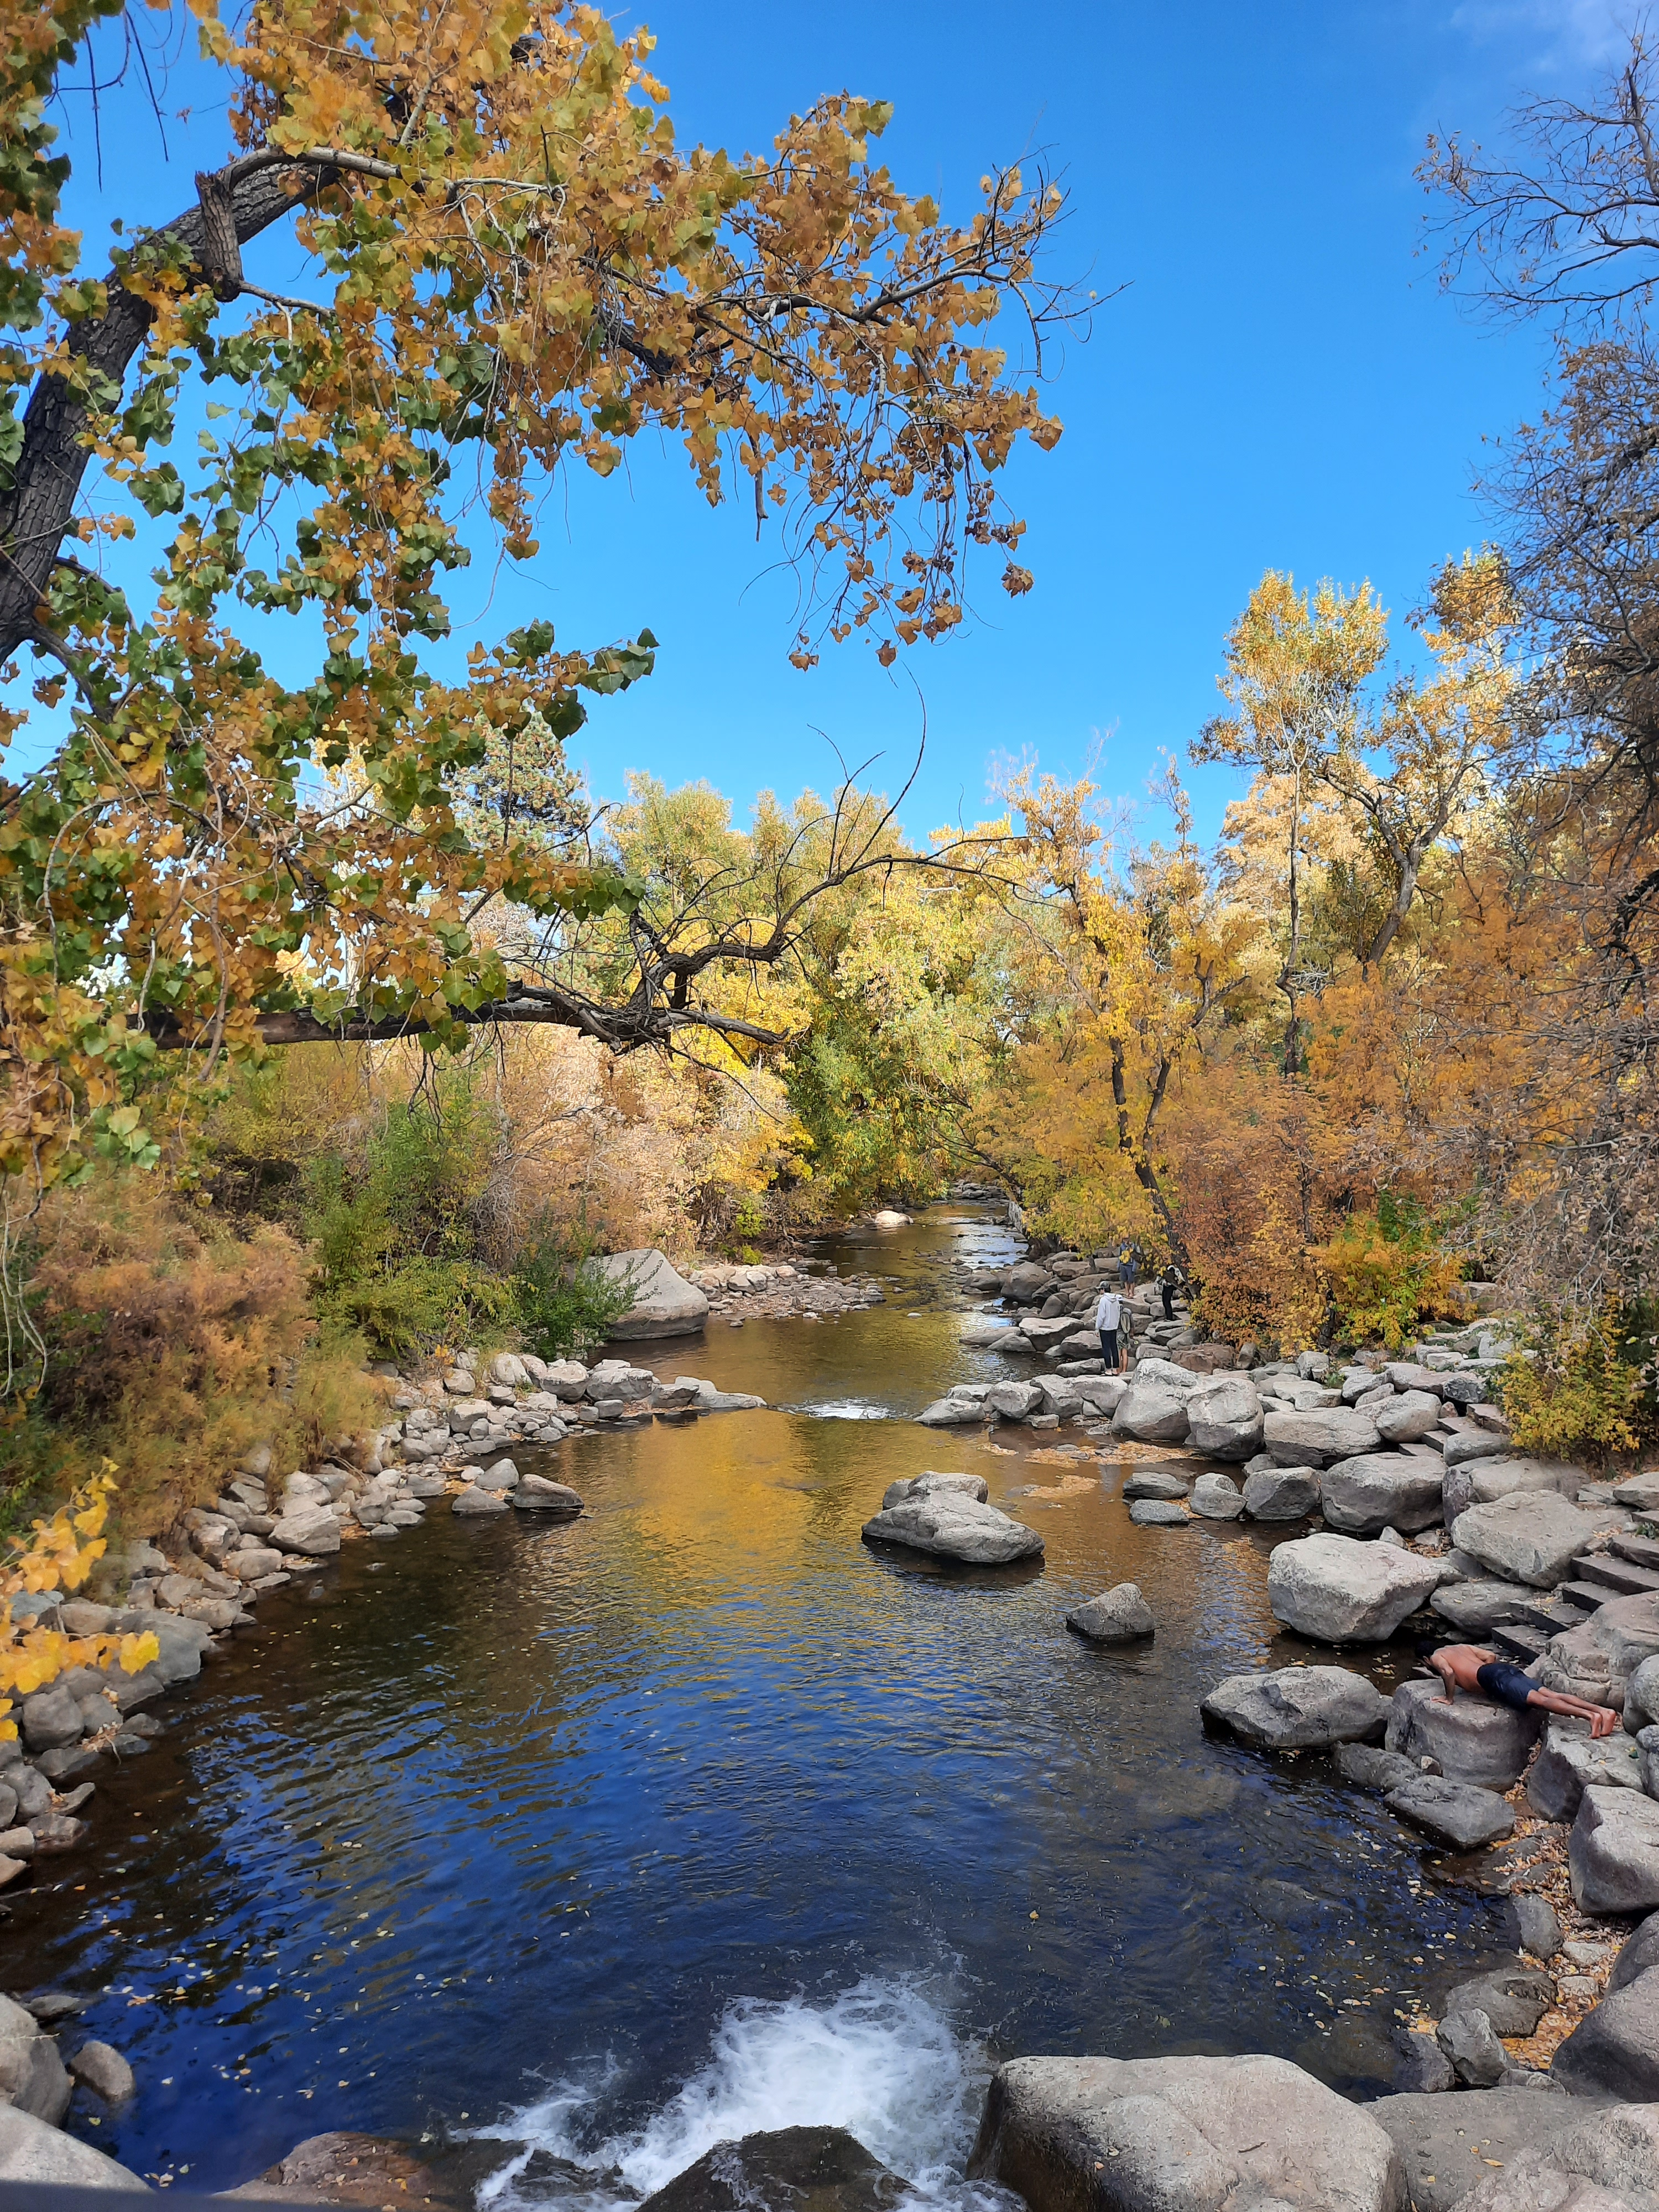


Rivers & Rocks
Integrating Channel Adjustments, Gravel Attrition, and Bedrock Wear in a Model of Long-Profile Evolution
Vanessa Gabel^{1, 2} and Greg Tucker^{1, 2}
¹Cooperative Institute for Research in Environmental Sciences
²Department of Geological Sciences, University of Colorado, Boulder
12 Dec 2022

Slide 2
Big take-away:
Upstream lithology affects downstream sediment load and erosion rates!
Observations & theory
Model development
Model behavior
Future applications

Slide 3
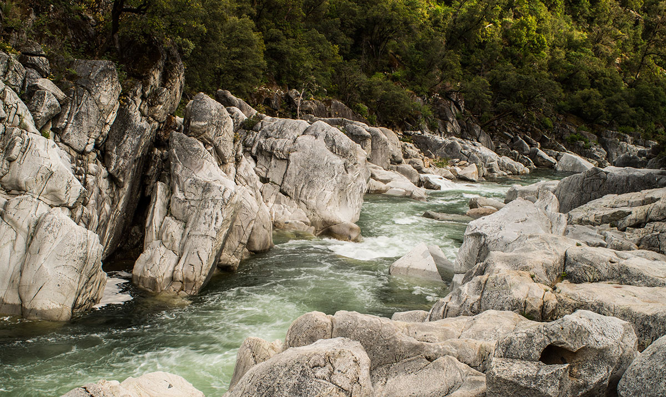
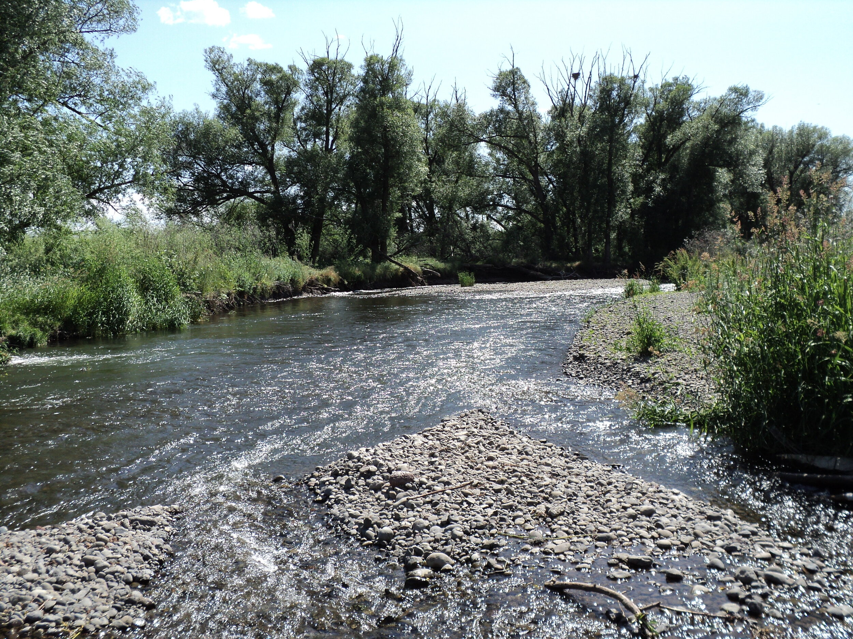
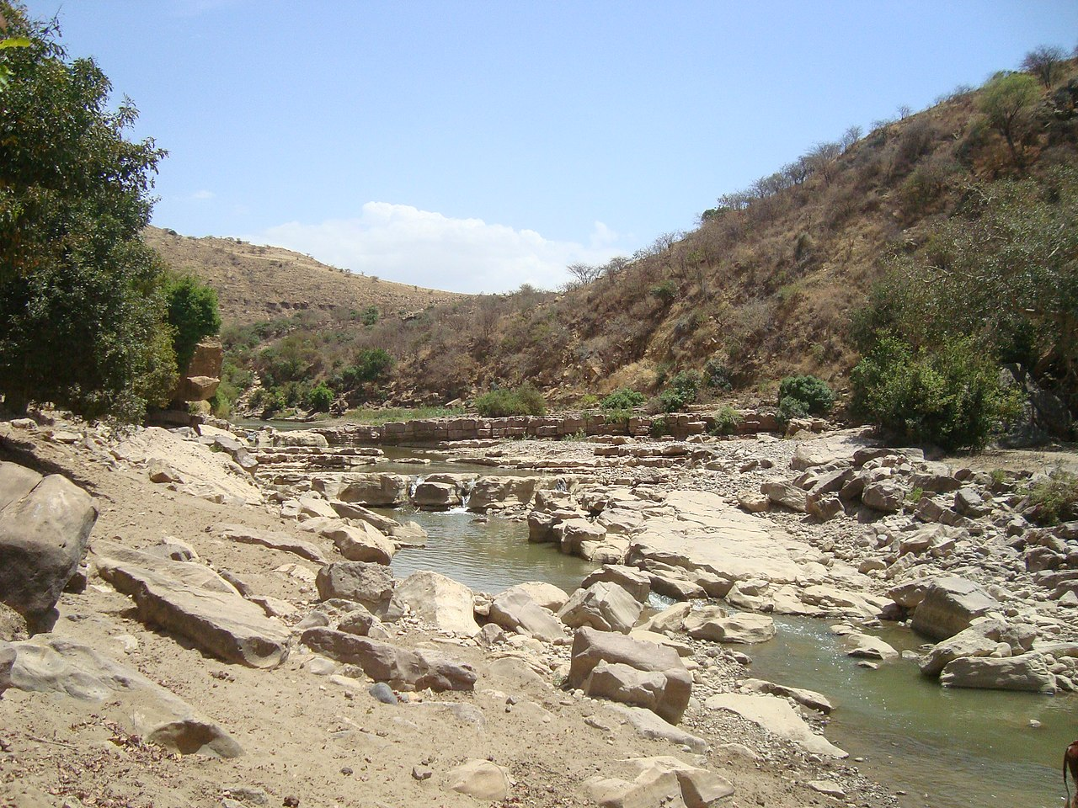
Bedrock Channels
Alluvial Channels
Mixed Channels
Width is confined
Concave-up profile
Slope scales with rock properties and discharge
Sediment acts as tool or cover
Width is self-adjusted
Concave-up profile
Graded transport slope
Downstream fining via selective transport and attrition
Width is self-adjusted within fixed valley
Slope adjusted to incision and sediment transport
Erode bedrock over long timescales, episodically alluviated
South Yuba River, Daniel Nylen
Mill Creek, The Science of Rivers
Giba River, Wikipedia

Slide 4
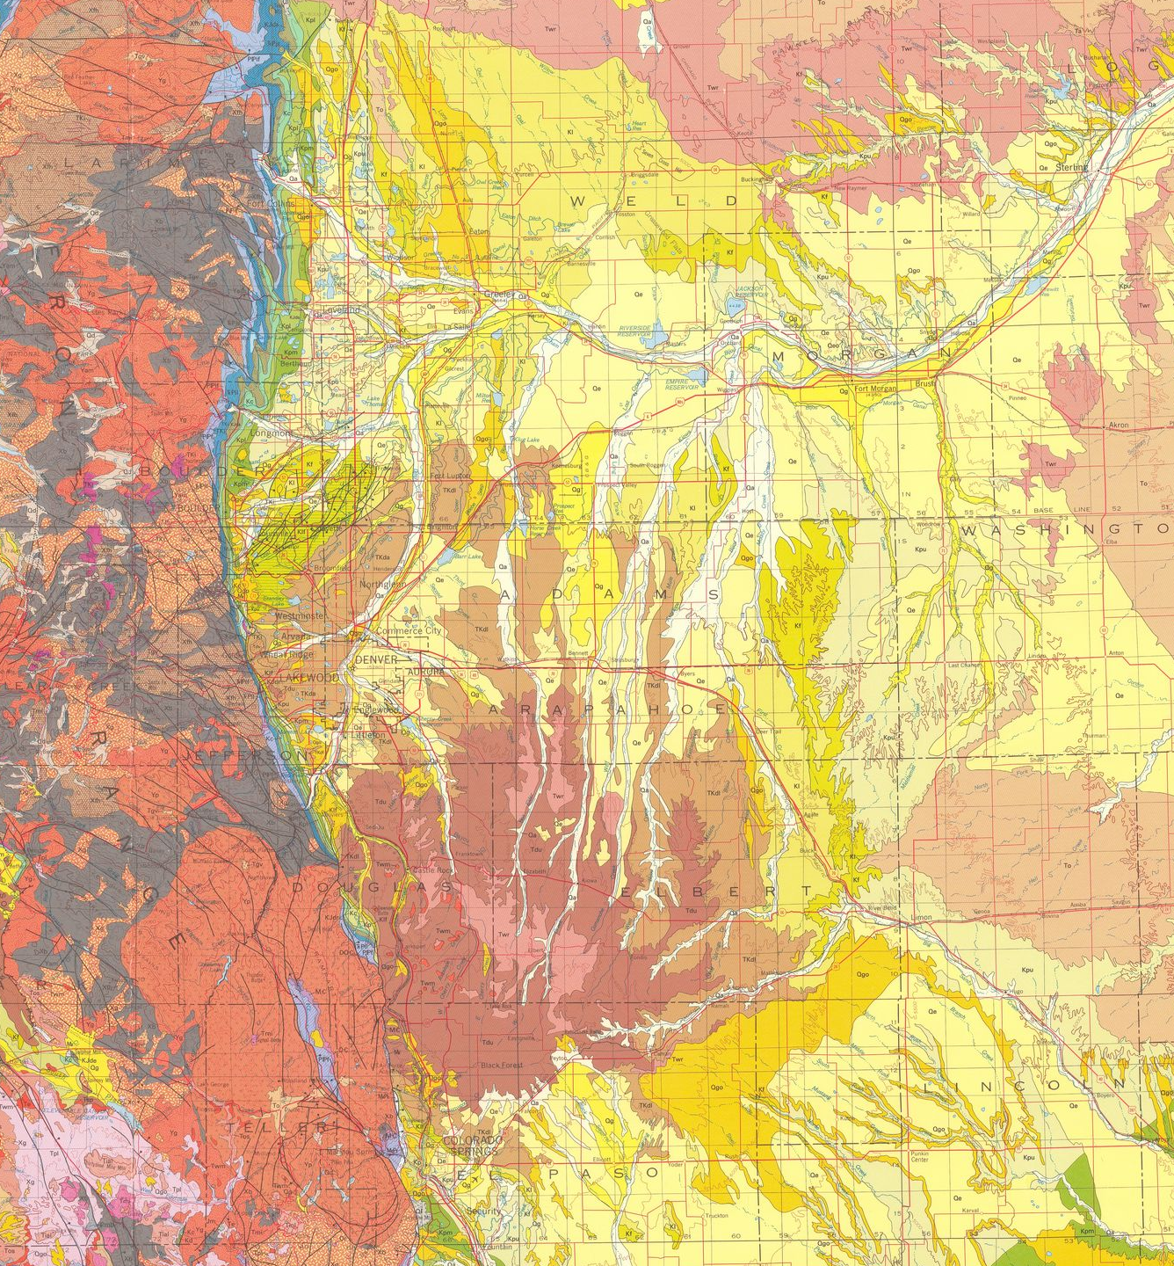
Hybrid river behavior is very common!

Slide 5
Our model builds upon previous efforts to capture the complexity of mixed bedrock-alluvial systems
Plucking = f(K, Q, S, alpha)
Abrasion = f(Q_s, beta, alpha)
Attrition = f(Q_s, beta)
Sedimentation = f(Q_s, attrition, plucking, qL)
Channel adjusts to flow and sediment characteristics
Sediment transport adheres to equilibrium channel theory
Mixed Channels
Bedrock is abraded by mobile sediment
Width is self-adjusted within fixed valley
Slope adjusted to incision and sediment transport
Erode bedrock over long timescales, episodically alluviated
Loss of bedload via grain attrition
Bedrock is plucked via stream power
Sediment cover modulates transport and erosion
Notes:
Bedload sediment transport in equilibrium channels
Channel width adjustment to flow and sediment characteristics
Abrasion of bedrock by mobile sediment
Plucking of sediment
Sediment cover effects
Loss of gravel-sized sediment via grain attrition

Slide 6
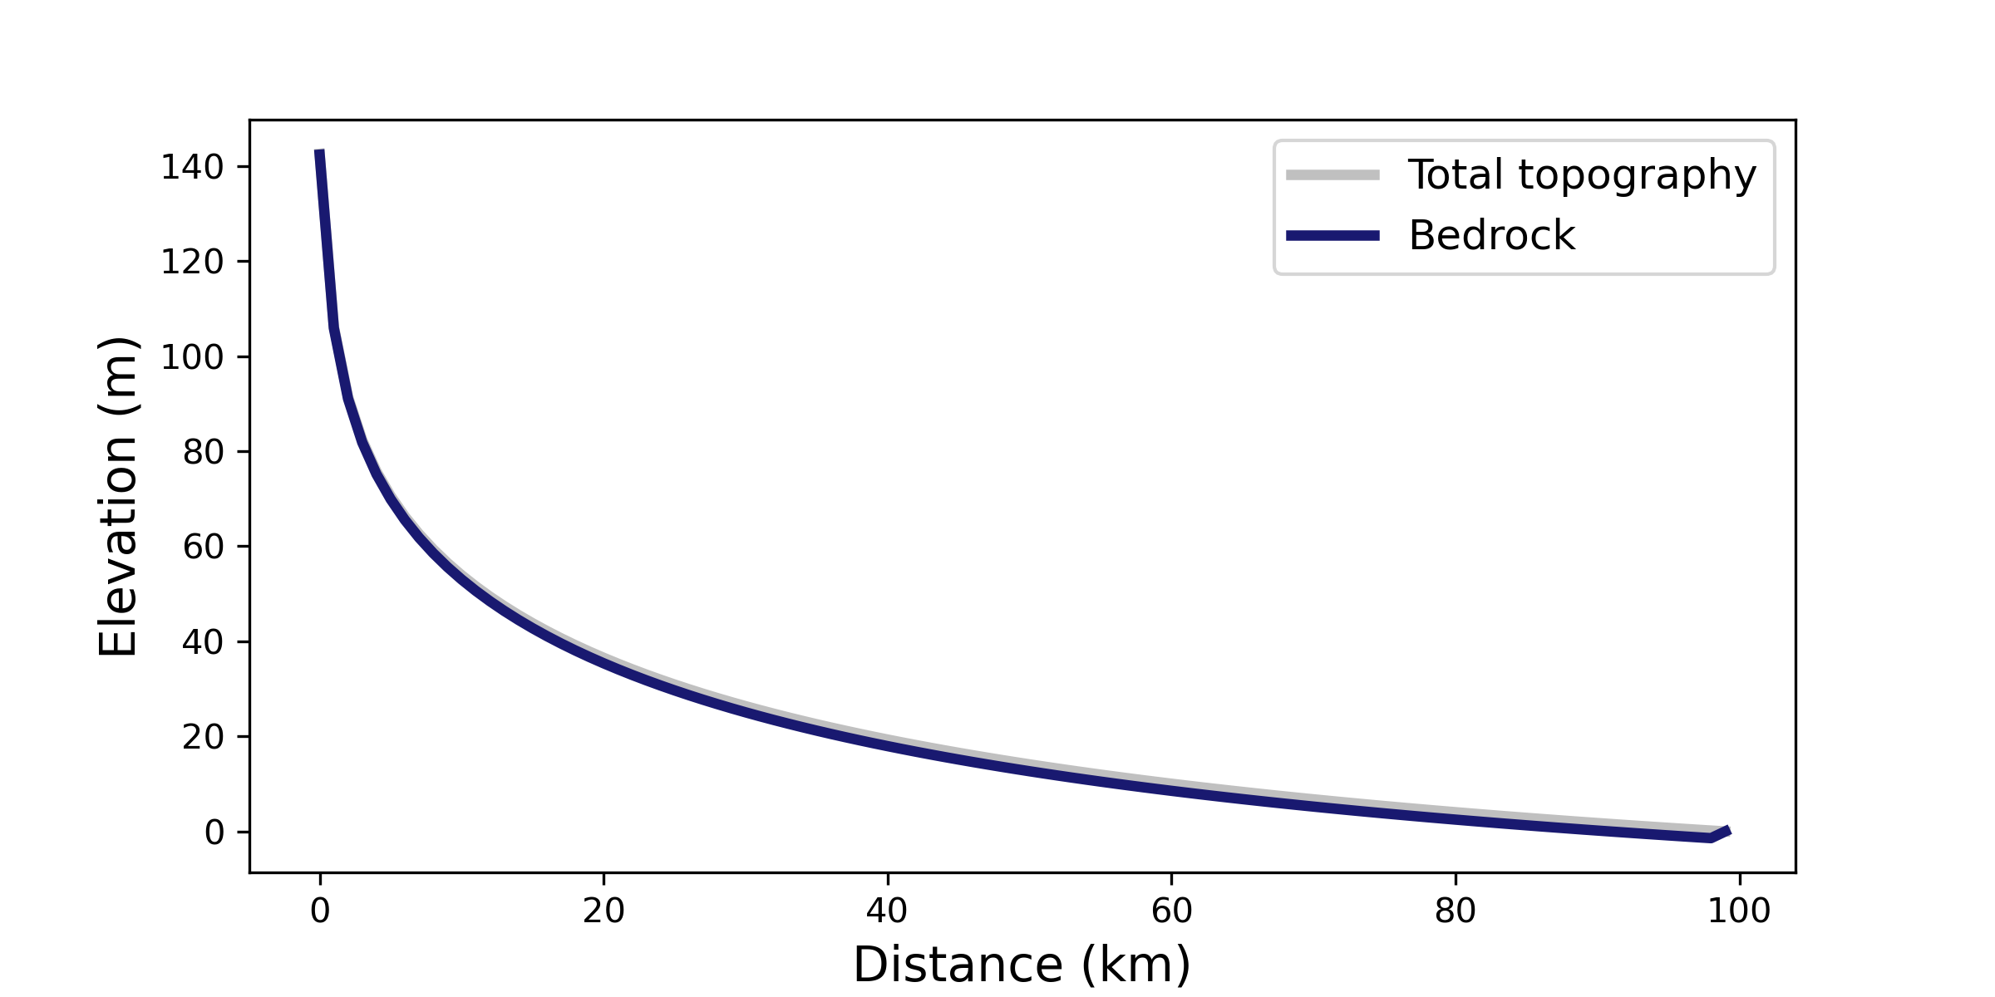
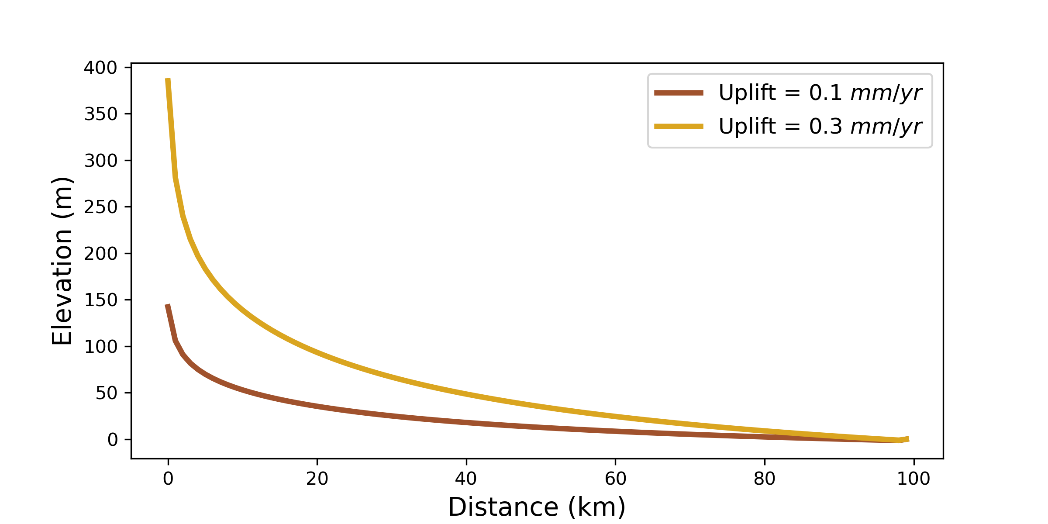
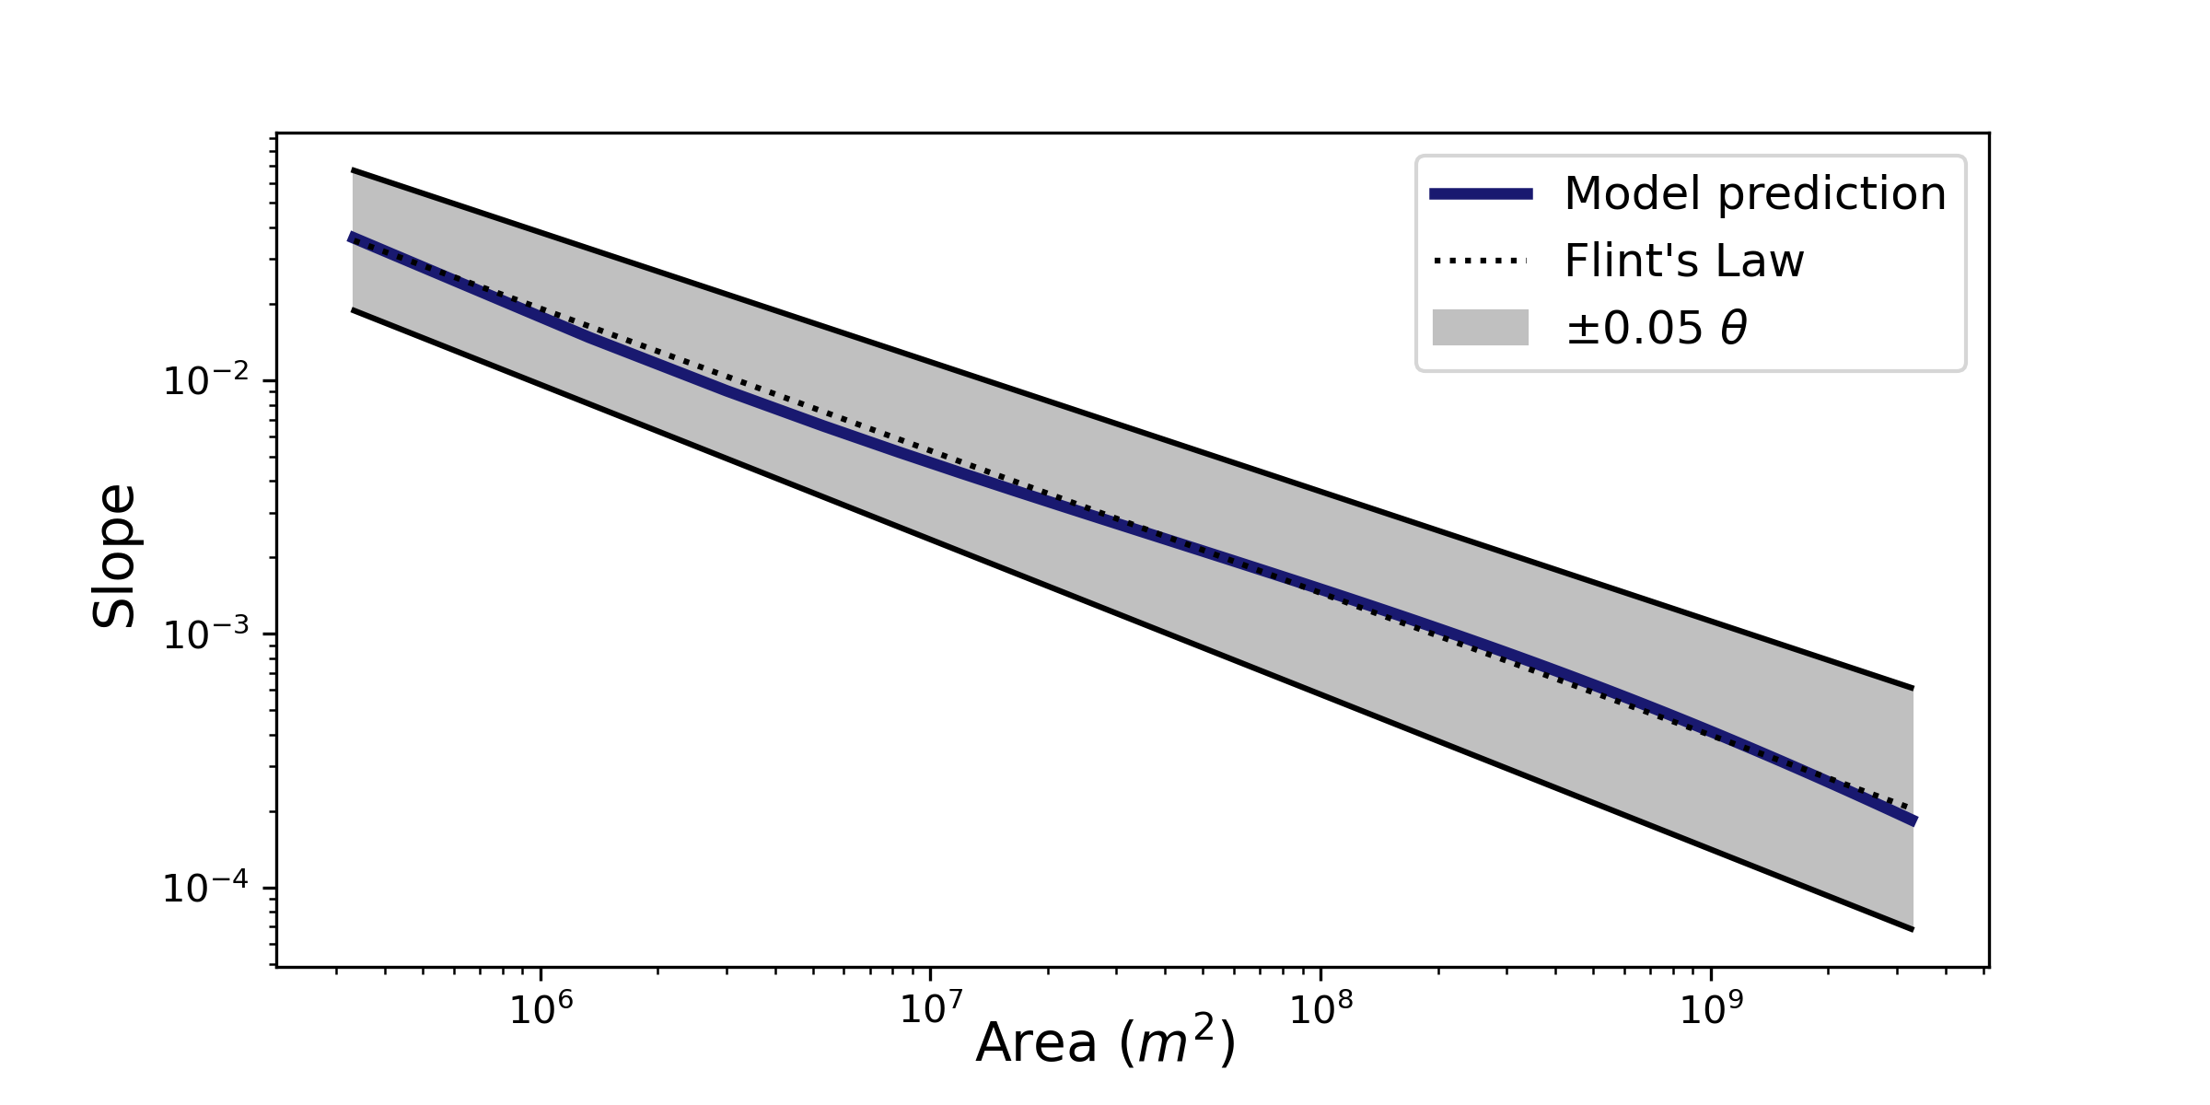
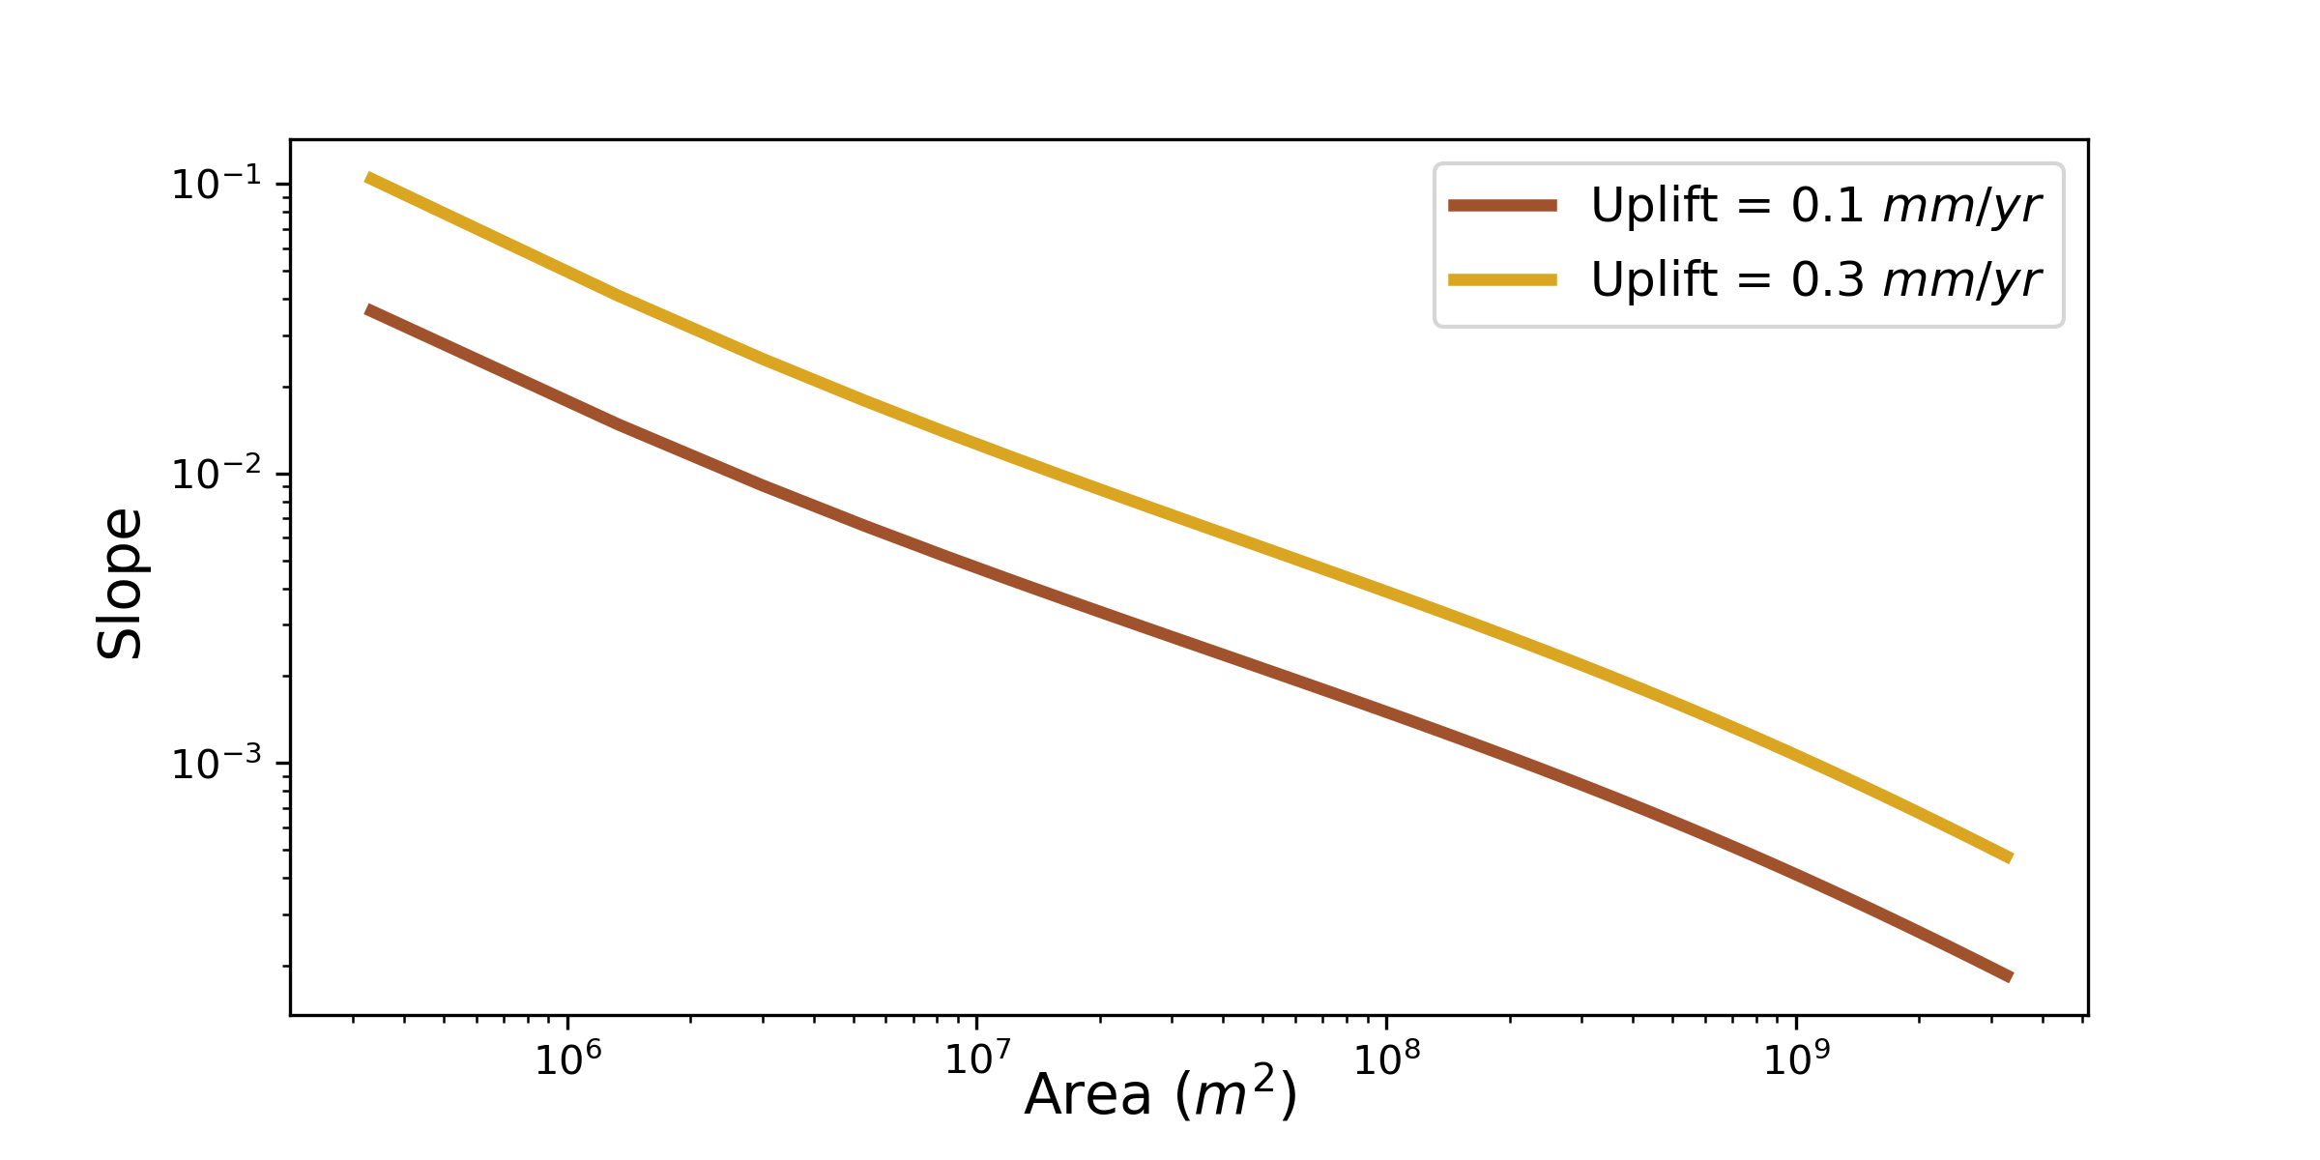
Our model reproduces expected fluvial behavior…
Slope - Area Scaling
Steepness - Uplift
Steepness - Uplift
Width and depth (plot on Phillips 2022) – WORKING SINCE CONVERTING TO M3/S!!!
Notes:
Show single lithology cases both for these plots and analytical solutions (if shown at all) – save this two lith stuff for last slide (future applications)

Slide 7
…while also adding nuance to bedrock-sediment interactions
Concavity with sed hardness
Types of erosion dominance plot
Transport vs erosion plot

Slide 8
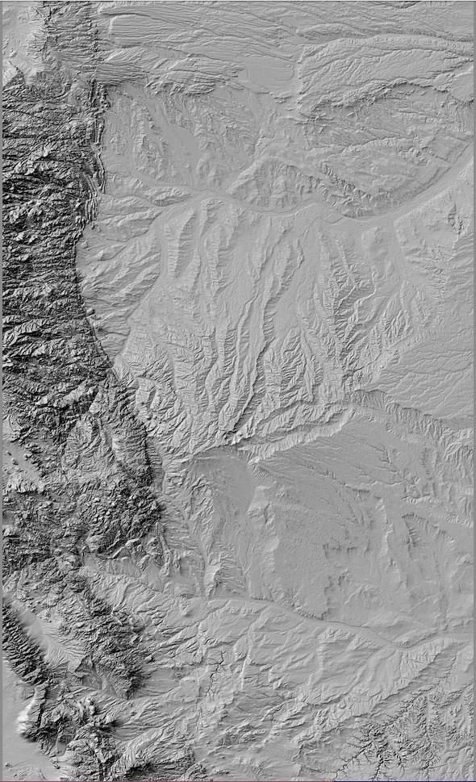
Future applications ben’s 2d version exploring external forcing channel response to landsliding erosion in lith. Het. environment

Slide 9
In Summary
Important stuff we learned

Slide 10
Questions?

Slide 11
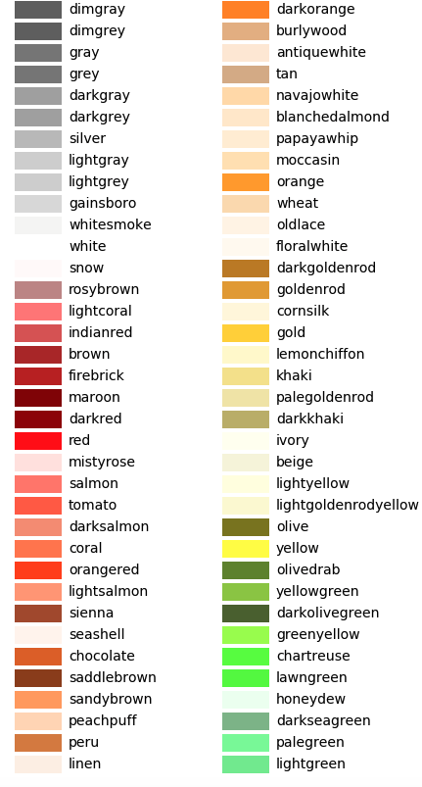
midnightblue
lightgrey
peru
goldenrod
darkgreen
dodgerblue
sienna
silver

Slide 12
Observations
Endmember paradigm – bedrock rivers and alluvial rivers
Complex landscapes have spectrum
Evolving understanding of these behaviors
Need model that moves in the direction of capturing this complexity!

